Slide 1
2 Tabular and Graphical Methods
Business Statistics:
Communicating with Numbers, 4e
By Sanjiv Jaggia and Alison Kelly
Copyright 2022 © McGraw Hill LLC. All rights reserved. No reproduction or distribution without the prior written consent of McGraw Hill LLC.

Slide 2
Chapter 2 Learning Objectives (L Os)
L O 2.1 Construct and interpret a frequency distribution for a categorical variable.
L O 2.2 Construct and interpret a bar chart and a pie chart.
L O 2.3 Construct and interpret a contingency table and a stacked bar chart for two categorical variables.
L O 2.4 Construct and interpret a frequency distribution for a numerical variable
L O 2.5 Construct and interpret a histogram, a polygon, and an ogive.
L O 2.6 Construct and interpret a scatterplot, a scatterplot with a categorical variable, and a line chart.
L O 2.7 Construct and interpret a stem-and-leaf diagram.

Slide 3
Introductory Case: House Prices in Punta Gorda 1
A relocation specialist for a real estate firm gathers recent house sales data for a client.
Transaction | Price | Sqft | Beds | Baths | Built | Type
1 | 200 | 1684 | 3 | 2 | 2005 | Single
2 | 435 | 2358 | 3 | 2.5 | 2017 | Single
… | … | … | … | … | … | …
40 | 192 | 1154 | 2 | 2 | 2019 | Condo
Use the sample information to:
Make summary statements concerning the range of house prices.
Comment on where house prices tend to cluster.
Examine the relationship between a house price and its size.

Slide 4
2.1 Methods to Visualize a Categorical Variable 1
A categorical variable consists of observations that represent labels or names.
Summarize the data with a frequency distribution.
Group the data into categories and record the number of observations that fall into each category.
The relative frequency for each category is the proportion of observations in each category.
Multiply the proportions by 100 to get percentages.

Slide 5
2.1 Methods to Visualize a Categorical Variable 2
Example: Myers-Briggs assessment personality types for 1,000 employees at a technology firm.
Personality | Frequency | Relative Frequency | Percent Frequency
Analyst | 116 | 0.116 | 11.6
Diplomat | 324 | 0.324 | 32.4
Explorer | 404 | 0.404 | 40.4
Sentinel | 156 | 0.156 | 15.6

Slide 6
2.1 Methods to Visualize a Categorical Variable 3
A bar chart depicts the frequency or relative frequency for each category of the categorial variable.
Series of either horizontal or vertical bars.
Bar lengths proportional to the values they are depicting.
A pie chart is a segmented circle whose segments portray the relative frequencies of the categories of a qualitative variable.

Slide 7
2.1 Methods to Visualize a Categorical Variable 4
Example: Myers-Briggs assessment personality types for 1000 employees at a technology firm.
Access the text alternative for slide images.

Slide 8
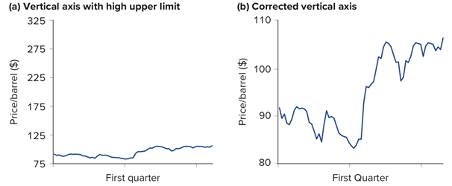
2.1 Methods to Visualize a Categorical Variable 5
The simplest graph should be used.
Axes should be clearly marked with numbers and scales.
Bars on bar charts should have the same width.
Vertical axis should not have a very high values as an upper limit.
Access the text alternative for slide images.

Slide 9
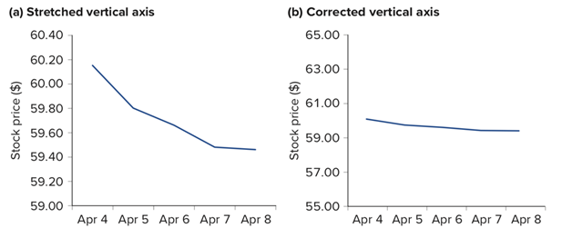
2.1 Methods to Visualize a Categorical Variable 6
Vertical axis should not be stretched.
Access the text alternative for slide images.

Slide 10
2.2 Methods to Visualize the Relationship Between Two Categorical Variables 1
Use a contingency table to examine the relationship between two categorical variables.
Frequencies for two categorical variables.
Each cell represents a mutually exclusive combination of the pair of values.
Use a stacked column chart to visualize more than one categorical variable.
Graphically shows the contingency table.
Allows for the comparison compositive within each category.

Slide 11
2.2 Methods to Visualize the Relationship Between Two Categorical Variables 2
Example: Myers-Brigg personality assessment and sex.
Personality
Sex | Analyst | Diplomat | Explorer | Sentinel
Female | 55 | 164 | 194 | 79
Male | 61 | 160 | 210 | 77
Access the text alternative for slide images.

Slide 12
2.3 Methods to Visualize a Numeric Variable 1
For a categorical, the raw data could be categorized in a well-defined way.
With a numerical variable, each observation represents a meaningful amount or count.
Use a frequency distribution to summarize a numerical variable.
Instead of categories, we construct a series of intervals or classes.
The data are more manageable using a frequency distribution, but some detail is lost.

Slide 13
2.3 Methods to Visualize a Numeric Variable 2
We have to make decisions about the number of intervals and the width of each interval.
The intervals are mutually exclusive.
The total number of intervals usually ranges from 5 to 20.
The intervals are exhaustive.
The intervals are easy to recognize and interpret.
A starting point for approximating the width of each interval is given by

Slide 14
2.3 Methods to Visualize a Numeric Variable 3
Example: house prices in Punta Gorda.
Suppose we are going to have 6 intervals.
The maximum is 649 and the minimum is 125.
As a starting point, the width of each interval could be:
This would not give limits that are easily recognizable, so we use 100.
Interval (in $1,000s) | Frequency
100 < x ≤ 200 | 9
200 < x ≤ 300 | 16
300 < x ≤ 400 | 8
400 < x ≤ 500 | 4
500 < x ≤ 600 | 2
600 < x ≤ 700 | 1

Slide 15
2.3 Methods to Visualize a Numeric Variable 4
In addition to a frequency distribution, there are three other items to compute.
Relative frequency: proportion (or fraction) of observations that falls into each interval.
Cumulative frequency: the number of observations that falls below the upper limit of a particular interval.
Cumulative relative frequency: the proportion (or fraction) of observations that falls below the upper limit of a particular interval.

Slide 16
2.3 Methods to Visualize a Numeric Variable 6
Example: house prices in Punta Gorda.
Use the previous frequency distribution to determine the below.
Interval (in $1,000s) | Frequency | Relative Frequency | Cumulative Frequency | Cumulative Relative Frequency
100 < x ≤ 200 | 9 | 0.225 | 9 | 0.225
200 < x ≤ 300 | 16 | 0.400 | 9 + 16 = 25 | 0.225 + 0.400 = 0.625
300 < x ≤ 400 | 8 | 0.200 | 9 + 16 + 8 = 33 | 0.225 + 0.400 + 0.200 = 0.825
400 < x ≤ 500 | 4 | 0.100 | 9 + 16 +....+ 4 = 37 | 0.225 + 0.400 +…+ 0.100 = 0.925
500 < x ≤ 600 | 2 | 0.050 | 9 + 16 +....+ 2 = 39 | 0.225 + 0.400 +…+ 0.050 = 0.975
600 < x ≤ 700 | 1 | 0.025 | 9 + 16 +....+ 1 = 40 | 0.225 + 0.400 +…+ 0.025 = 1.000

Slide 17
2.3 Methods to Visualize a Numeric Variable 7
A histogram is the counterpart to the vertical bar chart used for a categorical variable.
Graphically depict a frequency distribution for a numeric variable.
A series of rectangles.
Mark off the along the horizontal axis.
The height of each bar represents the frequency or relative frequency for each interval.
No gaps between bars/intervals.

Slide 18
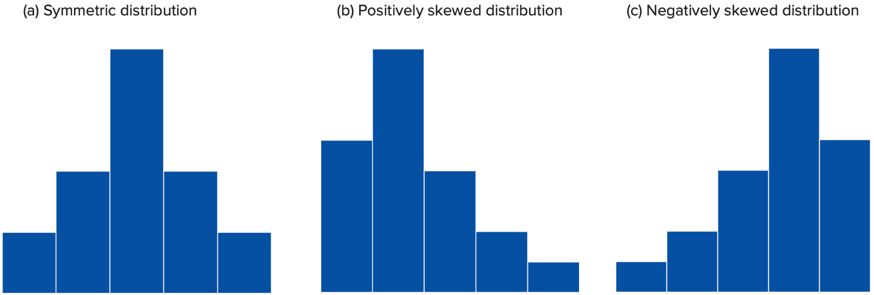
2.3 Methods to Visualize a Numeric Variable 8
A histogram allows us to quickly see where most of the observations tend to cluster.
A histogram indicates the spread and shape of the variable.
Symmetric: mirror image of itself on both sides of its center.
Skewed: positive (elongated right tail) or negative (elongated left tail).
Access the text alternative for slide images.

Slide 19
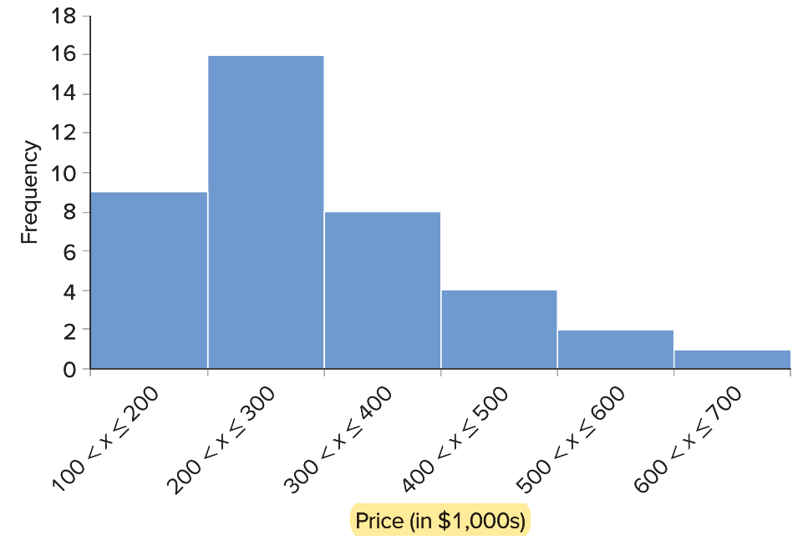
2.3 Methods to Visualize a Numeric Variable 9
Example: house prices in Punta Gorda.
Interval (in $1,000s) | Frequency
100 < x ≤ 200 | 9
200 < x ≤ 300 | 16
300 < x ≤ 400 | 8
400 < x ≤ 500 | 4
500 < x ≤ 600 | 2
600 < x ≤ 700 | 1
Access the text alternative for slide images.

Slide 20
2.3 Methods to Visualize a Numeric Variable 10
A polygon provides another way of depicting a frequency distribution.
Midpoint of each interval/class on the x-axis.
Frequency or relative frequency on the y-axis.
Connect neighboring points with a straight line.
A polygon gives a general idea about the shape of a distribution.

Slide 21
2.3 Methods to Visualize a Numeric Variable 11
Example: house prices in Punta Gorda.
Interval | X-coordinate (midpoint) | Y-coordinate (relative frequency)
0 < x ≤ 100 | 50 | 0
100 < x ≤ 200 | 150 | 0.225
200 < x ≤ 300 | 250 | 0.400
300 < x ≤ 400 | 350 | 0.200
400 < x ≤ 500 | 450 | 0.100
500 < x ≤ 600 | 550 | 0.050
600 < x ≤ 700 | 650 | 0.25
700 < x ≤ 800 | 750 | 0
Access the text alternative for slide images.

Slide 22
2.3 Methods to Visualize a Numeric Variable 12
An ogive depicts a cumulative frequency or cumulative relative frequency.
Upper limit of each interval/class on the x-axis.
Cumulative frequency or cumulative relative frequency on the y-axis.
Connect neighboring points with a straight line.
Close the ogive at the lower end by intersecting the x-axis at the lower limit of the first interval.

Slide 23
2.3 Methods to Visualize a Numeric Variable 13
Example: house prices in Punta Gorda.
Interval | X-coordinate (Upper limit) | Y-coordinate (cumulative relative frequency)
Lower limit of first class | 100 | 0
100 < x ≤ 200 | 200 | 0.225
200 < x ≤ 300 | 300 | 0.625
300 < x ≤ 400 | 400 | 0.825
400 < x ≤ 500 | 500 | 0.925
500 < x ≤ 600 | 600 | 0.975
600 < x ≤ 700 | 700 | 1
Access the text alternative for slide images.

Slide 24
2.4 More Data Visualization Methods 1
Use a scatterplot to examine the relationship between two numerical variables.
Determine if two numerical variables are related in some systematic way.
Each point represents a pair of observations of the two variables.
Refer to one variable as x (x-axis) and the other as y (y-axis).
Once plotted, the graph may reveal one of the below.
A linear relationship.
A nonlinear relationship.
No relationship.
Access the text alternative for slide images.

Slide 25
2.4 More Data Visualization Methods 2
Example: house prices and square footage in Punta Gorda.
Access the text alternative for slide images.

Slide 26
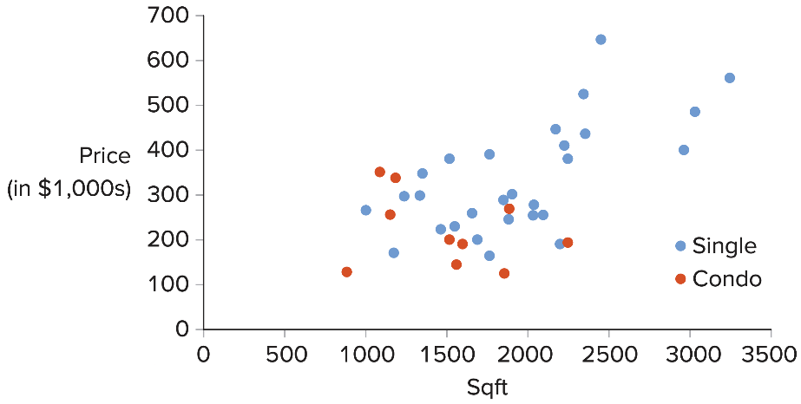
2.4 More Data Visualization Methods 3
A scatterplot with a categorical variable modifies a basic scatterplot.
Incorporate a categorical variable in addition to the two numeric variables.
Encode the categorical variable with color.
Giving each point a distinct hue makes it easy to show its category.
This allows you to determine if the relationship between x and y differs across the values of the categorical variable.
Example: house prices and square footage by type in Punta Gorda.
Access the text alternative for slide images.

Slide 27
2.4 More Data Visualization Methods 4
A line chart displays a numerical variable as a series of consecutive observations connected by a line.
A line chart is especially useful for tracking changes or trends over time.
It is also easy for us to identify any major changes that happened in the past on a line chart.
When multiple lines are plotted in the same chart, we can compare these observations on one or more dimensions.

Slide 28
2.4 More Data Visualization Methods 5
Example: monthly stock prices for Apple and Merck.
Access the text alternative for slide images.

Slide 29
2.5 A Stem-And-Leaf Diagram 1
A stem-and-leaf diagram provides another visual method for displaying a numerical variable.
It gives an overall picture of where the observations are centered and how they are dispersed from the center.
Separate each observation of a variable into two parts.
Stem: left-most digits.
Leaf: the last digit.

Slide 30
2.5 A Stem-And-Leaf Diagram 2
Example: age of the wealthiest people in the world.
Access the text alternative for slide images.

Slide 31
End of Main Content
Copyright 2022 © McGraw Hill LLC. All rights reserved. No reproduction or distribution without the prior written consent of McGraw Hill LLC.

Slide 32
Accessibility Content: Text Alternatives for Images

Slide 33
2.1 Methods to Visualize a Categorical Variable 4 – Text Alternative
Return to parent-slide containing images.
The horizontal axis is labeled Analyst, Diplomat, Explorer, and Sentinel under each bar and the vertical axis is labeled Relative Frequency. The vertical axis ranges from 0 to 0.5. The bar Analyst shows 0.116, Diplomat shows 0.324, Explorer shows a peak of 0.404, and Sentinel falls down to 0.156. All values are approximated.
A pie chart shows the relative frequency of each category for a categorical variable. Sentinel shows 16%, Analyst shows 12%, Diplomat shows 32%, and Explorer covers with the highest frequency of 40%.
Return to parent-slide containing images.

Slide 34
2.1 Methods to Visualize a Categorical Variable 5 – Text Alternative
Return to parent-slide containing images.
In the first graph, horizontal axis is labeled First quarter and vertical axis is labeled Price/barrel ($). The vertical axis ranges from 75 to 325. The graph shows a compressed line which starts at 90 with slight increase in price at 105 and ends at 110. In the second graph, horizontal axis is labeled First Quarter and vertical axis is labeled Price/barrel ($). The vertical axis ranges from 80 to 110. The graph shows a line curve with several crests and troughs. The curve starts at 92 and trends with a fall at 83 and again rises with a peak at 105 and ends at 108. All values are approximated.
Return to parent-slide containing images.

Slide 35
2.1 Methods to Visualize a Categorical Variable 6 – Text Alternative
Return to parent-slide containing images.
In the first graph, vertical axis is labeled Stock price ($). The horizontal axis ranges from Apr 4 to Apr 8 and the vertical axis ranges from 59.00 to 60.40. The graph shows a decreasing curve starts at (Apr 3, 60.15) and falls directly at (Apr 5, 59.80). The curve further falls at (Apr 6, 59.50) and ends at (Apr 7, 59.55). In the second graph, vertical axis is labeled Stock price ($). The horizontal axis ranges from Apr 4 to Apr 8 and the vertical axis ranges from 55.00 to 65.00. The graph shows a stagnant curve with slight decrease in it. The curve starts at (Apr 3, 60.00) and ends with a slight decrease at (Apr 7, 59.80). All values are approximated.
Return to parent-slide containing images.

Slide 36
2.2 Methods to Visualize the Relationship Between Two Categorical Variables 2 – Text Alternative
Return to parent-slide containing images.
The horizontal axis is labeled Analyst, Diplomat, Explorer, and Sentinel under each column and the vertical axis is labeled Frequency. The vertical axis ranges from 0 to 450. The lower stack represents female and the upper stack represents male. The frequency of female analyst is 55 whereas that of male is 61. The frequency of female diplomat is 164 and that of male is 160. The frequency of explorer in female is 194 whereas that of male rises to 210 but the frequency of Sentinel in female is 79 and that of male is 77.
Return to parent-slide containing images.

Slide 37
2.3 Methods to Visualize a Numeric Variable 8 – Text Alternative
Return to parent-slide containing images.
The first histogram is titled Symmetric distribution. It shows an equal distribution starts increasing gradually at a point and again falls back. The second histogram is titled Positively skewed distribution. It shows a positive distribution starts with a rise and skewed to the right leaving a long tail. The third histogram is titled Negatively skewed distribution. It shows a negative distribution starting from the lowest and gradually increases leaving a long tail on the left or one that is skewed to the left.
Return to parent-slide containing images.

Slide 38
2.3 Methods to Visualize a Numeric Variable 9 – Text Alternative
Return to parent-slide containing images.
The horizontal axis is labeled Price (in $ 1,000s) and the vertical axis is labeled Frequency and ranges from 0 to 18. The frequencies for the marked values are as follow: (100 less than x less than or equal to 200, 9); (200 less than x less than or equal to 300, 16); (300 less than x less than or equal to 400, 8); (400 less than x less than or equal to 500, 4); (500 less than x less than or equal to 600, 2); (600 less than x less than or equal to 700, 1).
Return to parent-slide containing images.

Slide 39
2.3 Methods to Visualize a Numeric Variable 11 – Text Alternative
Return to parent-slide containing images.
The horizontal axis is labeled Price (in $1,000s) and the vertical axis is labeled Relative Frequency. The horizontal axis ranges from 0 to 800 and the vertical axis ranges from 0 to 0.5. The graph shows a polygon which is positively skewed. It starts with a peak and skewed to the right. The coordinates are (50, 0), (150, 0.22), (250, 0.4), (350, 0.2), (450, 0.1), (550, 0.05), (650, 0.025), and (750, 0), respectively. All values are approximated.
Return to parent-slide containing images.

Slide 40
2.3 Methods to Visualize a Numeric Variable 13 – Text Alternative
Return to parent-slide containing images.
The horizontal axis is labeled Price (in $1,000s) and the vertical axis is labeled Relative Frequency. The horizontal axis ranges from 0 to 800 and the vertical axis ranges from 0 to 1. The graph shows an ogive chart. The coordinates are (100, 0), (200, 0.25), (300, 0.65), (400, 0.85), (500, 0.9), (600, 0.95), and (700, 1), respectively. The coordinate (250, 0.4) is intersected by dashed lines. All values are approximated.
Return to parent-slide containing images.

Slide 41
2.4 More Data Visualization Methods 1 – Text Alternative
Return to parent-slide containing images.
In the first scatterplot, the horizontal axis is labeled x and the vertical axis is labeled y. It shows a negative linear relationship. In the second scatterplot, the horizontal axis is labeled x and the vertical axis is labeled y. It shows a nonlinear relationship. In the third scatterplot, the horizontal axis is labeled x and the vertical axis is labeled y. It shows no relationship.
Return to parent-slide containing images.

Slide 42
2.4 More Data Visualization Methods 2 – Text Alternative
Return to parent-slide containing images.
The horizontal axis is labeled Square feet and the vertical axis is labeled Price (in $ 1,000s). The horizontal axis ranges from 0 to 3500 and the vertical axis ranges from 0 to 700. It shows strong positive pattern in the initial stage and gradually becomes weak at the end. The price of the square feet starts with 120 at 800 square feet. The price 650 is high at 2500 square feet. At 3250 square feet the price is 580. All values are approximated.
Return to parent-slide containing images.

Slide 43
2.4 More Data Visualization Methods 3 – Text Alternative
Return to parent-slide containing images.
The horizontal axis is labeled Square feet and the vertical axis is labeled Price (in $ 1,000s). The horizontal axis ranges from 0 to 3500 and the vertical axis ranges from 0 to 700. The scatterplot shows two types of houses. The highest price of single is 680 at 2500 square feet and the highest price of condo is 380 at 1000 square feet. The scatterplot for single shows positive pattern whereas that of condo shows no relationship.
Return to parent-slide containing images.

Slide 44
2.4 More Data Visualization Methods 5 – Text Alternative
Return to parent-slide containing images.
The vertical axis is labeled Stock Price (in $). The horizontal axis ranges from 01-01-2016 to 10-01-2019 and the vertical axis ranges from 0 to 350. The graph shows two line curves representing Apple and Merck. Merck shows the line curve in the vertical axis nearly horizontal. It starts at (02-01-2016, 48) and trends horizontally with slight increase at (11-01-2018, 60) and ends at (12-01-2019, 98). Apple shows an increasing line curve starts at (02-01-2016, 98), follows a rising trend at (08-01-2018, 230), with a slight fall at (12-01-2018, 150), and ends with a peak at (12-01-2019, 300). All values are approximated.
Return to parent-slide containing images.

Slide 45
2.5 A Stem-And-Leaf Diagram 2 – Text Alternative
Return to parent-slide containing images.
A stem and leaf diagram for age of the wealthiest people in the world. The diagram is plotted across three panels A, B and C.
Panel A: Stem 3, leaf blank; Stem 4, leaf blank; Stem 5, leaf 6; Stem 6, leaf blank; Stem 7, leaf blank; Stem 8, leaf blank.
Panel B: Stem 3, leaf 5; Stem 4, leaf 6, 6 and 8; Stem 5, leaf 6, 5 and 4; Stem 6, leaf 4, 2, 6, 3, 1 and 2; Stem 7, leaf 0, 5, 7, 1, 0 and 5; Stem 8, leaf 9, 0, 3, 4, 6 and 1.
Panel C: Stem 3, leaf 5; Stem 4, leaf 6, 6 and 8; Stem 5, leaf 4, 5 and 6; Stem 6, leaf1, 2, 2, 3, 4 and 6; Stem 7, leaf 0, 0, 1, 1, 5, 5 and 7; Stem 8, leaf 0, 1, 3, 4, 6 and 9.
Return to parent-slide containing images.

